Slide 1

Chapter 7: AI Ethics and Risks

Slide 2

DISCUSSION 7.1 SHOULD AI WRITE OUR LAWS?

Slide 3

Artificial Intelligence (AI)
Artificial Intelligence: A branch of computer science that aims to create machines or systems that can perform tasks typically requiring human intelligence. These tasks include:
Perception: Interpreting sensory input e.g. computer vision, speech recognition)
Reasoning: Drawing conclusions from available information

Slide 4

Artificial Intelligence (AI)
Learning: Improving performance over time through experience (e.g., machine learning)
Language Understanding: Processing human language, e.g., Natural Language Processing NLP
Acting: Making decisions or taking actions (e.g., robotics, game AI)

Slide 5
Types of AI
Type | Description | Example
Artificial Narrow Intelligence (ANI) | - Specializing in one task. - All training is done for a specific use. - All current systems are ANI | Siri, Google Translate
Artificial General Intelligence (AGI) | - Equal to human cognitive abilities across tasks. - Still theoretical | None yet
Artificial Superinteligence (ASI) | - Surpasses human intelligence in all aspects. - Hypothetical future state | Not yet developed

Slide 6
Components of AI
Machine Learning
Deep Learning
Computer Vision
Natural Language Processing
Large Language Models
Generative Pre-trained Transformers

Slide 7
Machine Learning
Allows systems to learn from data and improve their performance on a task without being explicitly programmed.
Example: A spam filter that gets better over time as it sees more emails.

Slide 8

Deep Learning
A type of machine learning that uses multi-layered neural networks to model complex patterns in large datasets
Example: Voice assistants recognizing your speech accurately

Slide 9

Computer Vision
A field of AI that enables machines to interpret and understand visual information from the world, images and videos.
Example: Self-driving cars detecting pedestrians and traffic signs

Slide 10
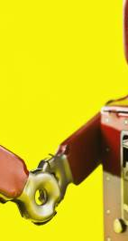
Natural Language Processing (NLP)
The branch of AI focused on enabling machines to understand, interpret, generate, and respond to human language.
Example: Chatbots, translation tools, and sentiment analysis

Slide 11

Large Language Models (LLM)
A type of AI that uses vast amounts of text data to learn and generate human-like language.
IT can understand, summarize, translate, and create new text based on the input it receives.
Example: ChatGPT, Grok, Google Gemini

Slide 12

Generative Pre-trained Transformer (GPT)
GPT is a specific type of LLM developed by OpenAI. It uses a neural network architecture called a Transformer and is trained on massive datasets to generate text that’s coherent and contextually appropriate.
Generative: It can produce new content
Pre-trained: it learns from a broad range of texts before fine-tuning
Transformer: a model architecture that’s capable at handling the nuances of language
Example: GPT -4 can answer questions, write code, or simulate conversations

Slide 13
Floridi’s Five Pillars of Ethical AI
Beneficence
Nonmaleficence
Autonomy
Justice
Explicability (Explainability)

Slide 14

Beneficence
The principle of Beneficence promotes Well-Being, Dignity, and Sustainability
Well-being of living things: AI should not only serve humans but also consider the welfare of all sentient beings that might be affected (humans, animals, and potentially other entities). This broadens the ethical scope beyond human-centered benefits.

Slide 15
Beneficence
Human Dignity: AI systems should respect individuals as ends in themselves, not merely as means. For example, AI in employment should enhance workers’ abilities rather than reducing them to data points or replaceable resources.
Sustainability: AI development must align with ecological responsibility. Beyond short-term economic gain, it should preserve environmental stability, minimize carbon footprints, and ensure resources for future generations.

Slide 16
Nonmaleficence (Do No Harm)
Data Protection:
AI must safeguard sensitive data, avoid mass surveillance, and prevent the erosion of personal identity.
AI should be designed to resist hacking and misuse. Unsecured AI in critical systems (e.g., power grids, healthcare devices) could have catastrophic consequences
Avoiding AI Arms Race and Capability Caution:
The Asilomar Principles warn against the militarization of AI and uncontrolled self-improvement (leading to ASI) that could spiral into unpredictable dangers.
Ethical governance is needed to prevent AI from being exploited in harmful geopolitical competitions.

Slide 17

Human Autonomy and Control
Human autonomy: An individual’s ability to make independent, informed decisions without undue influence or manipulation by AI systems.
It’s about ensuring that people remain in control of their lives and that AI does not override, coerce, or manipulate them
Human control: Refer to the oversight and governance mechanisms that ensure humans can supervise, guide, override, or stop AI systems, especially in high-risk situations

Slide 18
Levels of Human Control
Human-in-the-loop (HITL): AI assists, but a human makes the final decision. AI provides inputs or recommendations
Example: An AI model analyzes a chest X-ray and flags potential pneumonia, but the radiologist makes the final diagnosis
Human-on-the-loop (HOTL): The AI system acts autonomously, but a human monitors its performance and can intervene or override if necessary
Example: A self-driving car navigates roads independently, but the human driver can take control at any time.
Human-out-of-the-loop (HOOTL): The AI operates entirely autonomously, with no human involvement during decision-making or execution.
Example: AI curates and updates social media or news feeds without any user control or review, often nudging behaviour subtly

Slide 19

Risks caused by loss of autonomy or control
Automation Bias: People overtrusting AI, even when it’s wrong e.g., Doctors blindly following AI diagnostics
Manipulative Design: AI nudges or persuades users without them realizing e.g., Social media algorithms driving addiction
Loss of meaningful choice: AI decisions are opaque or pre-determined e.g., Personalized pricing without user consent

Slide 20
Risks caused by loss of autonomy or control
Lack of override mechanisms: Users can’t challenge or change an AI decision e.g., Credit scoring tools that don’t allow appeals
Autonomous weapons: AI systems make life-or-death decisions with no human input e.g., Lethal drones operating without human approval

Slide 21
Justice
It refers to the equitable and just treatment of individuals or groups by AI systems.
It means avoiding discrimination, bias, or favouritism, especially based on sensitive attributes like race, sex, age, or socioeconomic status.
Challenges:
AI systems can inherit and amplify biases present in the data they’re trained on.
Biased data can lead to discriminatory outcomes, e.g. the US court system’s use of the COMPAS algorithm which revealed racial bias in predicting reoffenders

Slide 22
Unfair AI: The COMPAS algorithm
COMPAS (Correctional Offender Management Profiling for Alternative Sanctions) is a risk assessment tool developed by Equivant . It’s used in the US criminal justice system to assess the likelihood that a defendant will:
Reoffend
Fail to appear in court
Engage in violent behaviour
Judges use this tool to inform decisions about bail, parole, and sentencing.

Slide 23


Slide 24
Unfair AI: The COMPAS Algorithm
In 2016, an investigation by ProPublica found significant racial bias in COMPAS:
False positives: Black defendants were twice as likely as white defendants to be incorrectly labeled high-risk
False negatives: White defendants were more often labeled low-risk but went on to commit new crimes
Opaque system: Defendants and even judges couldn’t see how the scores were generated
Feedback loop: Risk scores influenced decisions that could lead to more policing and arrests, especially in marginalized communities

Slide 25
Types of Biases in AI systems
Type | Description | Example
Historical Bias | Bias already present in the data | Loan approvals reflecting past racial discrimination
Representation Bias | Under/ overrepresentation of groups in data | Face recognition systems that are trained mostly on lighter-skinned faces
Measurement Bias | Using flawed or proxy indicators | Using zip code as a proxy for creditworthiness
Algorithmic Bias | Arises from how models process data | Predictive policing reinforcing arrests in certain neighborhoods

Slide 26
Promoting Fairness in AI Design
Diverse data collection – Include underrepresented groups.
Bias audits and fairness testing – Test outcomes for different demographics.
Human oversight – Let people review and override automated decisions.

Slide 27
Explicability
This pillar focuses on the transparency and explainability of AI systems
AI systems must be understandable for both experts and ordinary users.
By understanding how AI works and how it reaches its decisions, we can be clear about who is responsible for AI outcomes.

Slide 28
Transparency
Transparency in AI systems refers to how much access and visibility do stakeholders have into the data, design, development process, and functioning of an AI system.
What data was used to train the model?
Who built the system and under what guidelines?
Is the code or the algorithm used open for scrutiny?
Are the users aware they’re interacting with AI?

Slide 29
The “Black Box” Problem
Some AI models, especially deep learning systems, are so complex that their internal logic becomes inaccessible, even to their creators. This is the result of:
Complex models: Deep Learning models can have millions or billions of parameters, and the model may detect patterns that are not interpretable by humans
Lack of documentation: In commercial systems, the internal working are often propriety and not accessible to the public
Emergent behaviour: AI systems may develop unexpected strategies or correlations the developers never anticipated

Slide 30
Solutions to the Black Box Problem
Model Simplification: Use interpretable models (e.g., decision trees) when possible
Post-hoc Explanation Tools: LIME, SHAP which help highlight which features influenced decisions
Auditability: Keep detailed logs of how decisions were made
Human-in-the-loop systems: Ensuring ways that humans can review or override the AI’s output.

Slide 31

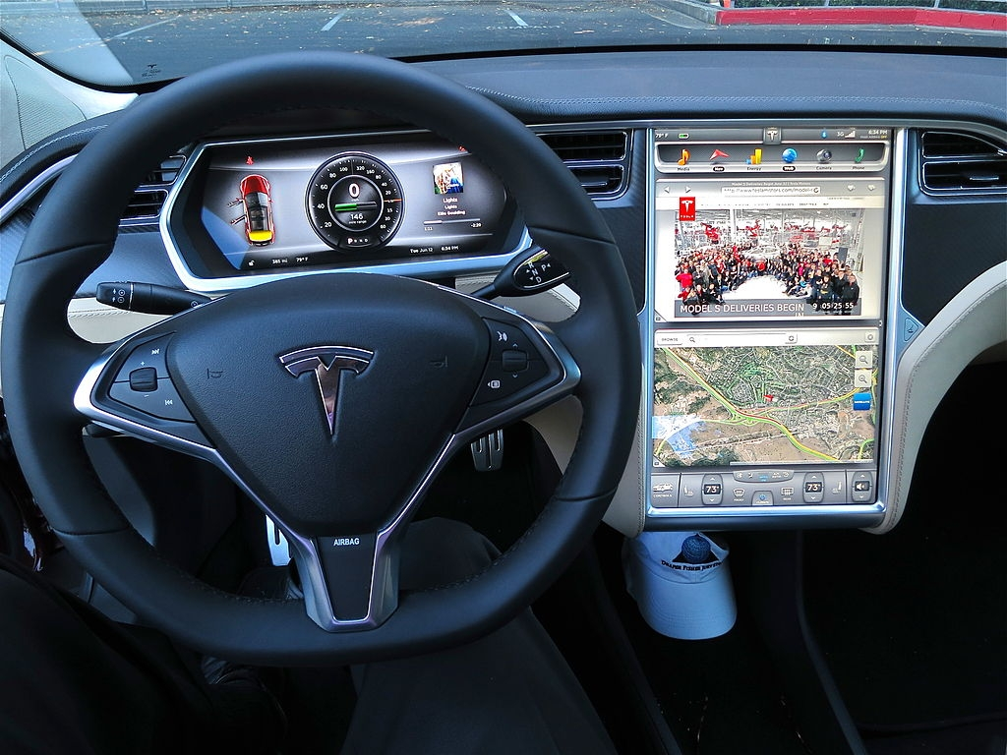
Explainability
This pillar goes hand-in-hand with transparency.
Explainability refers to the ability to make an AI system’s behaviour and decision-making understandable to humans.
Transparency is showing you what is under the hood, but you may not necessarily understand how it works
Explainability is like a car dashboard, where the driver understands what’s going on in the car (speed, temperature, sensors, etc)

Slide 32
Techniques for Explainable AI (XAI)
Feature Importance: Shows which input features mattered the most in a decision
Example: A model shows that “income level” had the biggest impact on loan approval
Counterfactual Explanations: Shows how different input would have led to a different outcome.
Example: “If your credit score had been 20 points higher, your loan would have been approved”.
Decision Trees: Known to be simple, hierarchical if-then rules making it easy for humans to trace the logic step-by-step

Slide 33
Techniques of Explainable AI (XAI)
Local Interpretable Model-agnostic Explanations (LIME): A post-hoc explanation – meaning they explain a decision after it’s been made, without needing to alter the model.
Method:
Take a single decision that needs explanation (e.g., why a model classified a customer as high-risk?)
Slightly change the features to create similar inputs and get the model’s predictions
Fit the results in a simple model (like linear regression) to these local predictions
Show which features had the most influence on that specific decision.

Slide 34
LIME Strengths and Limitations
Strengths | Limitations
Works with any black-box model | Only explains one instance (prediction) at a time
Easy to use and model-agnostic | Unstable at times – different runs can give slightly different explanations
Good for local interpretability | Doesn’t always capture the global model behaviour

Slide 35
Techniques of Explainable AI (XAI)
Shapley Additive Explanations (SHAP): Based on Game theory and Shapley values, which fairly distribute “credit among features for a particular outcome
Method:
Treat each input feature like a “player” in a game contributing to the model’s input
Calculate how much each feature contributes to the final prediction- by considering all possible combinations of features
Produce global and local explanations

Slide 36
SHAP Strengths and Limitations
Strengths | Limitations
Theoretically sound (solid math) | Computationally expensive, especially for large datasets
Provides consistent and fair attributions | Can be complex for non-technical audiences
Explains both local and global behaviour
Offers visualizations that are useful and intuitive

Slide 37
Summary
AI systems now perform perception, reasoning, learning, and language tasks traditionally done by humans.
Ethical AI requires compliance with Floridi’s Five Pillars: beneficence, nonmaleficence, human autonomy & control, justice, and explicability.
Loss of human control leads to risks such as automation bias, manipulation, lack of meaningful choice, and autonomous lethal systems.
AI can reproduce and amplify social and racial biases (e.g., COMPAS case).
Transparency and explainability (XAI) are essential to address the black-box problem.

